Slide 1


TEAM ALTITUDE COEP TECHNOLOGICAL UNIVERSITY
TEAM MEMBERS
Saikishore Naidu
Vijaysingh Rajput
Soham Kumthekar
Prathviraj Chavan
Ishan Kulkarni
Kalyani Vidhate
Krushal Mahajan
Bhushan Sonawane
Shivam Mishra
Anushka Shalu

Slide 2
Index
1 | Conceptual Design
2 | Detailed Design
3 | Final Specs and Bill of Materials
4 | Methodology for autonomous operations
5 | Summary of innovations in design

Slide 3
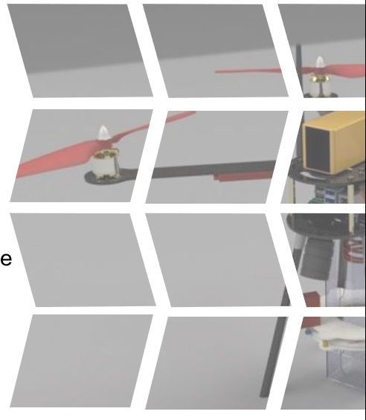
Conceptual Design
Quadcopter with X- configuration
Motors mounted on the rotor arms
connected to the central hub
Central hub consists of a upper and a lower plate
also act as power distribution board
Battery in between the two plates
Flight controller and microcontroller on the upper plate
Payload dropping and camera mechanism
attached to the bottom plate

Slide 4
Detailed Design
1. Preliminary weight estimation:
Frame | 250gm
Electronic components | 600gm
Battery | 500gm
Payload Mechanism | 350gm
Total | 1700 gm (Appx.)

Slide 5
Detailed Design
2. Estimation of Thrust Required:
Considering the 2:1 ratio of thrust to take-off weight, approximate thrust:
= 2 x take-off weight
= 4 kg.
Thrust required by each motor = (total thrust/no. of motors) +20% = 1.2 kg
The thrust force = 1.2 x 9.81 = 11.772 N
this is approximately 1.2kgf of thrust force.

Slide 6
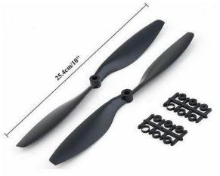
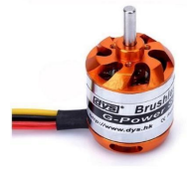
Detailed Design
3. Propulsion System:
Electric propulsion system with
DYS D2836-7 1120KV Outrunner Brushless Drone Motor and double blade propellers.
Large flange and vertically upside Motor Mounting

Slide 7
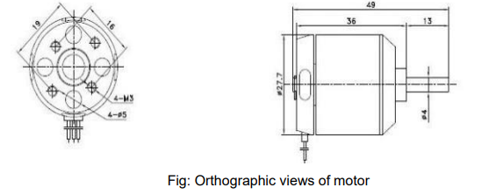
Detailed Design
Reasons for selection of DYS D2836-7 1120KV Outrunner Brushless Drone Motor:
The net weight of the quadcopter is 2kg.
This motor gives 1130g required thrust when applying 3s LiPo battery.
This motor gives 1120 rpm per volt.
Each cell gives 3.7 V so net voltage by the 3 pack of cells is 11.1 Volt.
So, each motor gets voltage according to required rpm and thrust requirement.

Slide 8
Detailed Design
TECHNICAL SPECIFICATION OF BLDC MOTOR:
Parameter | Value | Parameter | Value
Brand name | DYS | Weight | 70gm (including connectors)
Model | D2836-7 | Max. power | 336W
Operating voltage | 7.4-14.8 V | Screw size | M3
KV rating | 1120 | Max Current | 18A
Shaft dimensions | Ф4.0*49mm | No load current | 1A
Recommended ESC | 40A

Slide 9
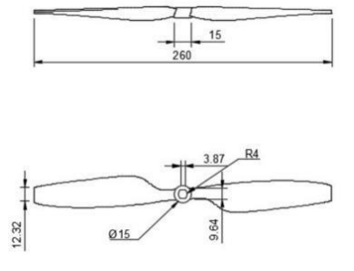
Detailed Design
Specifications:
Material | Carbon Nylon
Size | 10 × 4.5''
Weight | 26g per pair
Shaft diameter | 9.64mm
Hole size | 3.87mm

Slide 10
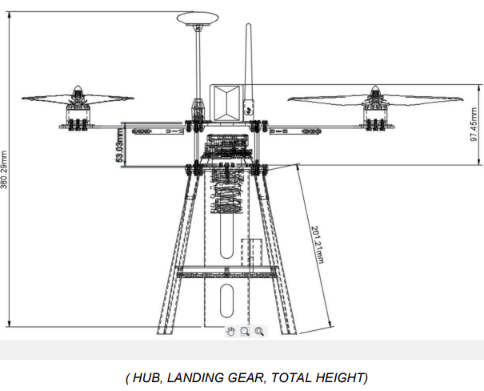
Detailed Design
UAV SIZING
COMPONENT NAME | SIZE (MM)
Rotor Arm | 276.5
Hub Length | 254
Wheel Base | 508
Propeller Clearance | 65
Payload Mechanism Height | 190
Landing Gear (Length, Height, Angle) | 207,199, 15
Drone Height (Except GPS and Telemetry) | 300

Slide 11
Detailed Design
UAV Performance
The time provided for completing the flight is 10mins. This is the major influencer for
battery selection and power requirements.
Battery: A. Choosing:
Compared to Li-po, Li-ion has more specific energy, but it is
more volatile, heavier
vulnerable to damage from high temperatures,
loses its capacity to charge
may burst if the separator is destroyed.
Ni-MH battery has
Low Power to Weight Ratio
Cell Voltage of just 1.2 V compared to Li-Po battery
3. As a result, we chose lithium polymer batteries.

Slide 12
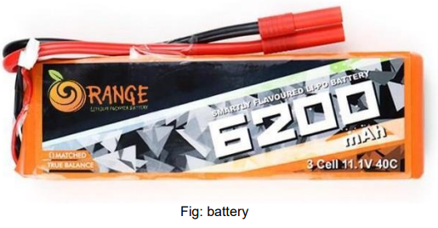
Detailed Design
UAV Performance
B. Calculations:
1. In Li-po batteries each cell has 3.7 V. Thus, a 3S battery will have 3 x 3.7= 11.1 V
This is within the operating range for our motors.
2. For longer flight time, the capacity should be good
Battery Selected:
3S (11.1V), 6200MAH, 40C LI-PO BATTERY

Slide 13
Detailed Design
Other Specifications of Li-Po:
Model No. | ORANGE 6200/3S-40C | Balance Plug | JST-XH
Capacity (mAh) | 6200 | Length, Width (mm) | 155, 25
Weight (gm) | 446 | Height (mm) | 25
Output Voltage (VDC) | 11.1 | Max. Burst Discharge I | 50C (310A)
Charge Rate | 1 ~ 3 | Max. Charge Rate | 5 C
Discharge Plug | HXT 4mm | Max. Continuous Discharge | 40C (248A)

Slide 14
Detailed Design
Flight time estimation:
The approximate flight time can be calculated as: Battery Current Capacity x 60 (min). Current drawn
As maximum current drawn is due to the motors, we can neglect the other components
The maximum current drawn by motor is 18A for the maximum thrust of 1130gm.
For hovering the drone 600 gm of thrust from each motor required.
Average current drawn estimated at 7-8 A per motor.
Average current drawn by all motors will be 8 x 4 = 32 A
So, the estimated time of flight will be (6.2/32) x 60= 11.625 min.
This value is not entirely accurate, but we have considered upper limit of the average current range to get a better estimate.

Slide 15
Detailed Design
Material Selection
1.Carbon Fibre Reinforced Polymer (CFRP)
a) Reasons for selecting CFRP
Extremely strong and lightweight
High strength to weight ratio of 2457 kN.m/kg
Carbon fibre is corrosion resistant and chemically stable
Excellent resistance to corrosion and impact, ensures drone frame can withstand potential collisions
b)Parts made of CFRP
Arms
landing gear(Legs)
For landing gear, we have used 3k twill rod of carbon fibre
top plate
bottom plate

Slide 16
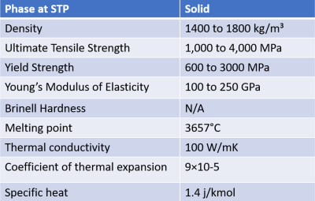
Detailed Design
Material Selection
Carbon Fibre Reinforced Polymer (CFRP)
b) Properties of CFRP

Slide 17
Detailed Design
Material Selection
1.Glass Fibre Reinforced Polymer (GFRP)
a) Reasons for selecting GFRP
It is lighter than steel but possesses comparable
Its toughness and impact resistance help protect the internal components
Excellent electrical insulator
Easy to shape
b)Use of GFRP
For coating the ABS mounts and the arms and hub joining area

Slide 18
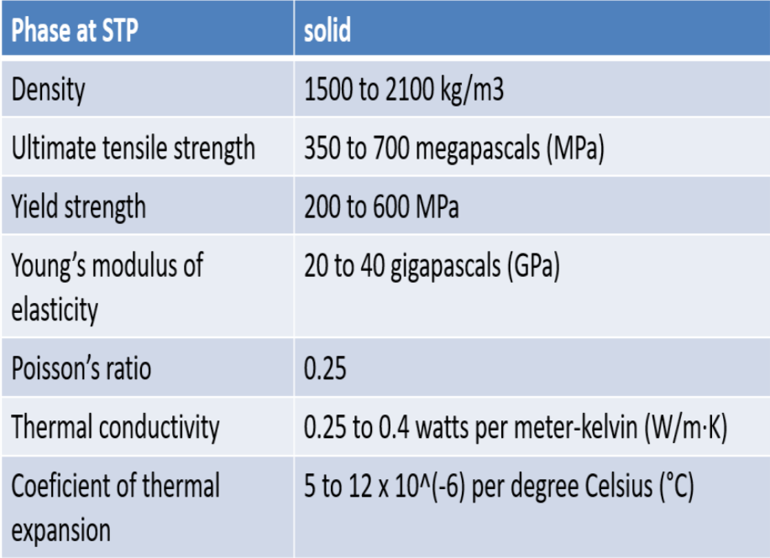
Detailed Design
Material Selection
Glass Fibre Reinforced Polymer (GFRP)
b) Properties of GFRP

Slide 19
Detailed Design
Material Selection
1.ABS (Acrylonitrile Butadiene Styrene)
a) Reasons for selecting ABS
Can be easily molded and shaped
3D printable
Tough material with good impact resistance
Prevents fractures and increases the overall durability of the drone parts
b)Use of ABS
We are using ABS for landing gear mounts

Slide 20
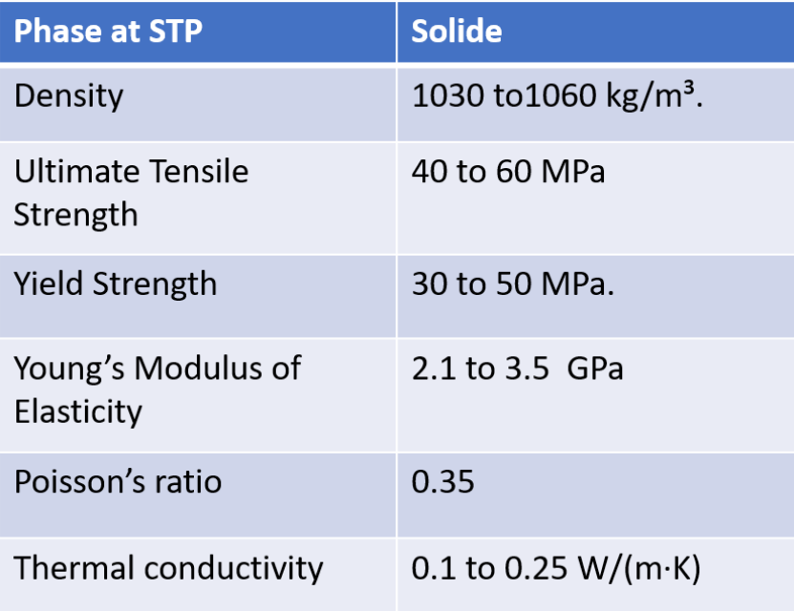
Detailed Design
Material Selection
ABS (Acrylonitrile Butadiene Styrene)
b) Properties of ABS

Slide 21
Detailed Design
Material Selection
4.Acrylic sheets
a) Reasons for selecting Acrylic sheets
More impact-resistant than glass
Exhibit good dimensional stability over a wide range of temperatures
Excellent electrical insulators

Slide 22
Detailed Design
Material Selection
Acrylic sheets
b) Properties of Acrylic sheets
Density= 1170 to 1200 g/cm³
Ultimate Tensile strength= 60 to 80 Mpa
Thermal conductivity= 0.19-0.20 W/(mK)
c)Use of Acrylic sheets
We are using acrylic for the payload dropping mechanism

Slide 23
Subsystem Selection - Communication system
The drone is controlled by a Transmitter
Control Modes
mode 1-
Throttle right
mode 2-
Throttle left
mode 3-
Throttle right but with the control sticks switched
mode 4-
Throttle left but with the control sticks switched

Slide 24
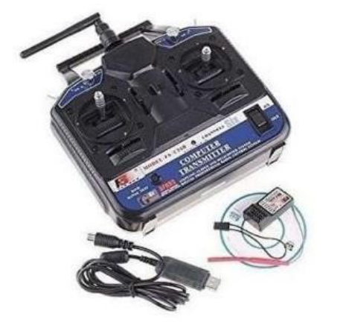
Subsystem Selection - Communication system
Transmitter Used- FS-CT6B
Transmitter performance:
1.Operates at 2.4 GHz
-less prone to interference than lower frequency
radio systems
2.Has an output power of less than 100 mW
-can be used legally without a license in most
countries

Slide 25
Subsystem Selection - Communication system
SPECIFICATIONS OF FS-CT6B Transmitter
Channels: 6 CH (can program by PC with the included software )
Control Distance: Up to 1000 meters in the air
High receiving sensitivity
Super active and passive anti-jamming capabilities
Use a linear spread of fine paragraph by an excess antenna
It covers the entire bandwidth of the antenna bandwidth range
Operating Voltage: 12 V
Very low power consumption
Weight: 511 gm
Dimension: 189x97x295 mm

Slide 26
Subsystem Selection -Control & Navigation System
Navigation Subsystem Used:
M8N GPS
-high-precision Global Navigation Satellite System
(GNSS) receiver module

Slide 27
Subsystem Selection -Control & Navigation System
SPECIFICATIONS OF M8N GPS
GNSS system
compatible with the Global Navigation System (GPS) and the Russian Global Navigation Satellite System (GLONASS)
it can receive signals from both GPS and GLONASS satellites to provide more accurate and reliable location information
Chipset: uses the u-blox M8N chipset a high performance GNSS receiver Positioning Accuracy: up to 2.5 meters
Refresh rate: up to 10 Hz (10 updates of position, speed and time data per second)

Slide 28
Subsystem Selection -Control & Navigation System
SPECIFICATIONS OF M8N GPS
4. Antenna: built-in ceramic patch antenna (no need for an external
antenna)
5. Interfaces: Has a number of interfaces, including UART, I2C and USB
(easy to interface with a variety of devices)
6. Power consumption: low power consumption of only 45mA
7. Operating Temperature Range: -40°C to 85°C
8. Size: 25mm x 25mm x 4mm

Slide 29
Subsystem Selection -Control & Navigation System
Camera Module: Raspberry Pi High Quality Camera
Specifications of Raspberry Pi High Quality Camera
1.Sensor: 12.3-megapixel Sony IMX477 sensor (improved image quality)
2.Lens Compatibility: It has a C-mount lens mount
-Allows for the attachment of various interchangeable lenses
-Flexibility in choosing different lenses and adjusting focus, iris, and other lens
settings
3.Image Quality:
-Capable of capturing detailed images with reduced noise
-Better low-light performance compared to the standard camera
module.

Slide 30
Subsystem Selection -Control & Navigation System
Camera Module: Raspberry Pi High Quality Camera
Specifications of Raspberry Pi High Quality Camera
4.Video Recording:
-It supports video recording at resolutions up to 1080p at 30 frames per
second
-It also supports hardware-accelerated video encoding, which helps reduce
the load on the Raspberry Pi processor
5.Accessories: These accessories can enhance our photography capabilities
-C-mount lens
-lens adapter

Slide 31

Subsystem Selection -Control & Navigation System
Camera Module: Raspberry Pi High Quality Camera
Specifications of Raspberry Pi High Quality Camera
6.Connection:
-It is specifically designed for use with Raspberry Pi boards
-It connects to the Raspberry Pi via a ribbon cable and interfaces with
the camera interface (CSI) connector on the Raspberry Pi board
7.Configuration: We will need to enable the camera interface on the Raspberry Pi. Open the Raspberry Pi Configuration Tool by entering the command in the terminal
In the configuration tool, navigate to “Interfacing Options” and select “Camera.” Choose “Yes” to enable the camera interface, then exit the configuration tool

Slide 32
Subsystem Selection -Control & Navigation System
Camera Module: Raspberry Pi High Quality Camera
Specifications of Raspberry Pi High Quality Camera
8.Programmability:
-Various software libraries or commands can be used to access and control
the camera module
-The official Raspberry Pi software, such as the raspistill 18 and raspivid
commands, can be used to capture images and record videos
-We can use programming languages like Python and libraries such as
OpenCV to access and process the camera data

Slide 33
Subsystem Selection -Control & Navigation System
Transmitter-Receiver:
Boscam 32Ch Wireless AV Transmitter TS832
Channels: The TS832 transmitter supports 32 selectable channels, allowing us to choose the desired frequency for transmission.
Transmission Power: Adjustable transmission power levels, typically ranging from 200mW to 600mW, providing flexibility
Input/Output: The transmitter accepts audio and video signals from a compatible source, typically through RCA or AV cables. It also features an SMA antenna connector for an external antenna.
Compatibility: The TS832 transmitter is commonly used with FPV cameras or other video sources to wirelessly transmit the video feed to a receiver.

Slide 34
Subsystem Selection -Control & Navigation System
Boscam RC832 Receiver:
Channels: The RC832 receiver is designed to receive the wireless audio and video signals transmitted by the TS832 transmitter. It supports 32 selectable channels, allowing you to match the frequency with the transmitter.
Antenna: The receiver comes with an SMA antenna connector for attaching an external antenna to improve reception.
Output: The RC832 receiver provides audio and video output through RCA or AV cables, allowing you to connect it to a display or recording device.
Connection: Connect Receiver Antenna to the mobile device using USB cable.

Slide 35
Subsystem Selection -Control & Navigation System
Flight Controller: Pixhawk
Pixhawk supports integration with a variety of sensors to gather data about the aircraft’s environment and its own state. Some commonly used sensors that can be connected to a Pixhawk system:
Inertial Measurement Unit (IMU): The IMU consists of accelerometers, gyroscopes, and magnetometers. Provides information about the UAV’s attitude, acceleration, and orientation.
Global Positioning System: GPS receivers provide accurate positioning and navigation data. They are crucial for autonomous flight, waypoint navigation, and precise positioning.
Barometer: Barometric pressure sensors measure atmospheric pressure changes to estimate the UAV’s altitude.
Compass: Compass sensors detect the Earth’s magnetic field and help determine the UAV’s heading. They are essential for accurate orientation and navigation.
Proximity Sensors: Proximity sensors, such as ultrasonic or LiDAR sensors, detect nearby obstacles and enable obstacle avoidance capabilities.

Slide 36
Subsystem Selection -Control & Navigation System
Flight Controller: Pixhawk
Airspeed Sensor: Airspeed sensors measure the relative airspeed of the UAV, providing crucial data for stabilizing flight, controlling airspeed
Voltage and Current Sensors: Monitor the battery voltage and consumption of the UAV, allowing for real-time battery status monitoring, estimation of remaining flight time, and voltage-based failsafe features.
Optical Flow Sensors: Optical flow sensors track the ground movement beneath the UAV, enabling precise position hold, altitude control, and stabilization in environments with limited GPS availability
Telemetry Radio: While not a sensor itself, a telemetry radio module is used to establish a wireless communication link between the Pixhawk and a ground control station, enabling real-time data transmission and remote control of the UAV.

Slide 37
Subsystem Selection -Control & Navigation System
Raspberry Pi
The Raspberry Pi 4 Model has various ports that allow for versatile connectivity. Main ports and connections available on the Raspberry Pi 4 are:
1. HDMI Ports: Two micro-HDMI ports (HDMI 2.0) that support up to 4K resolution.
2. USB Ports: There are two USB 2.0 ports and two USB 3.0 ports on the Raspberry Pi 4
3. Ethernet Port: The Raspberry Pi 4 has a Gigabit Ethernet port, allowing for fast and reliable wired network connectivity.
4. USB-C Power Port: USB-C power connector for power supply
5. GPIO Pins: The Raspberry Pi 4 features a 40-pin GPIO header, which provides access to a wide range of programmable I/O pins.

Slide 38
Subsystem Selection -Control & Navigation System
Raspberry Pi
MicroSD Card Slot: microSD card for operating system and storage.
Camera and Display Interfaces: The Raspberry Pi 4 has a MIPI CSI camera interface for connecting a Raspberry Pi camera module and a MIPI DSI display interface
Audio/Video Jack: The Raspberry Pi 4 has a 3.5mm audio/video jack that supports stereo audio output and composite video output.
Wireless Connectivity: The Raspberry Pi 4 has built-in wireless connectivity options. It supports dual-band 2.4GHz and 5GHz Wi-Fi (802.11b/g/n/ac) and Bluetooth 5.0.

Slide 39
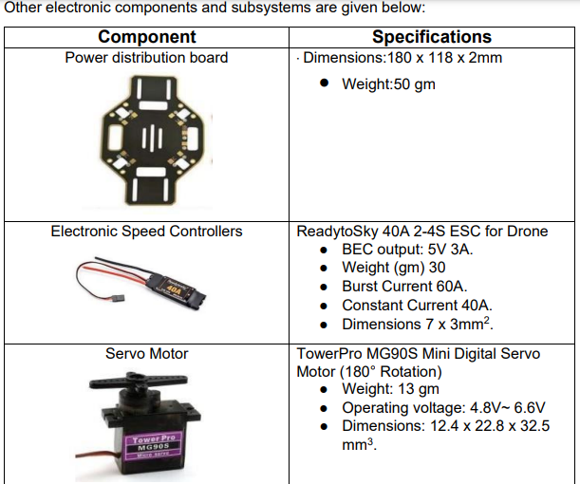
Subsystem Selection -Control & Navigation System

Slide 40
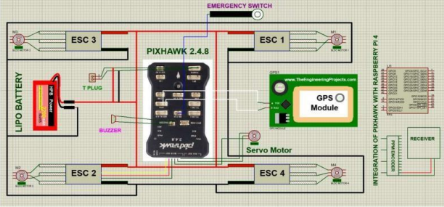
Subsystem Selection -Control & Navigation System
Pixhawk Connections:

Slide 41
Payload dropping mechanism
Our innovative payload dropping mechanism draws inspiration from the natural mechanisms found in the human eye pupil and camera iris.
It utilizes acrylic sheets to construct a cuboidal-shaped structure that houses the mechanism.
The iris is controlled by a servo motor, allowing it to open and close with precision.
The mechanism consists of an interior space specifically designed to accommodate the payload.
At the top of the mechanism, a spring is incorporated into the structure, serving to firmly secure the payload between the iris and the roof of the mechanism.
When the iris opens, triggered by the servo motor, the spring force propels the payload along a downward trajectory.

Slide 42
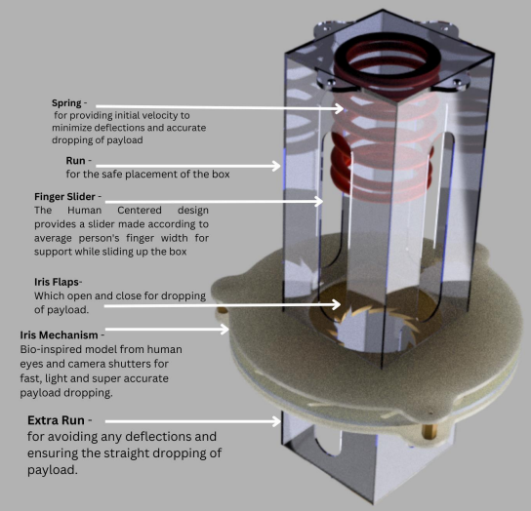
Payload dropping mechanism

Slide 43
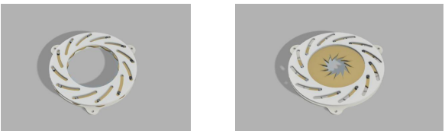
Payload dropping mechanism
The slots in the side are made so that he can easily slide the payload box upwards.
The screws are given on the outside to have a novel approach to convenient design
The efficient dropping of payload is ensured by first imparting velocity by the spring.
We have a longer run for the payload mechanism in order for it to adjust for any deflection and ensure straight dropping of payload.
Our payload system is engineered to be light, accurate and provides a dependable and precise payload release mechanism
The mechanism’s walls guide the descending cargo, ensuring controlled descent.

Slide 44
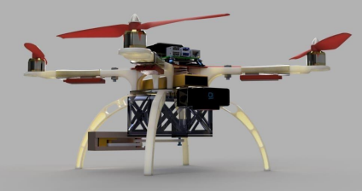
Preliminary Computer Aided Design Model

Slide 45
Preliminary Computer Aided Design Model
The 450 frame, landing gear of 17 cm, and payload mechanism of slider crank two flap opening mechanism, combined with the ABS frame covered in GFRP, results in a strong and adaptable drone design. It offers the requisite stability, functionality, and payload deployment capabilities

Slide 46
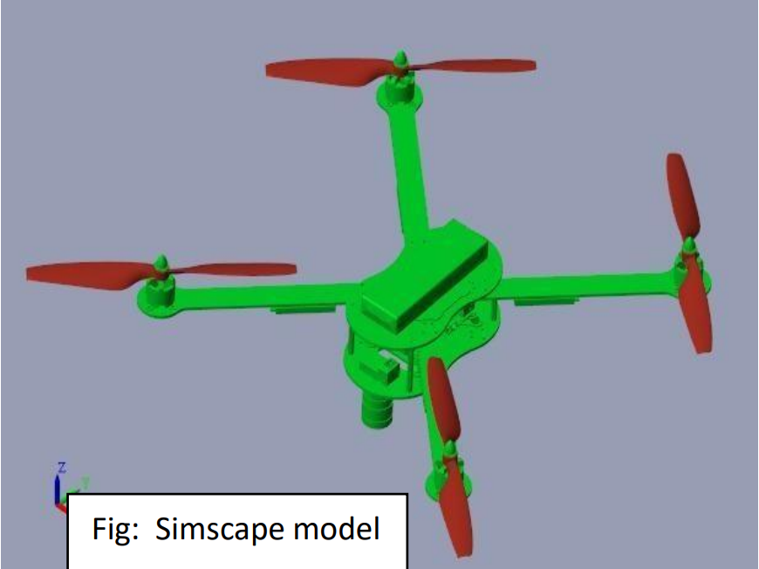
Computational Analysis
Kinematic analysis using MATLAB:
Model used to analyse our drone’s motion- MATLAB/Simulink
We imported our CAD model and studied its behaviour by giving rotation to the propellers, thus analysing the stability
- observed the effect of direction of propeller rotation on the
quadcopter body

Slide 47
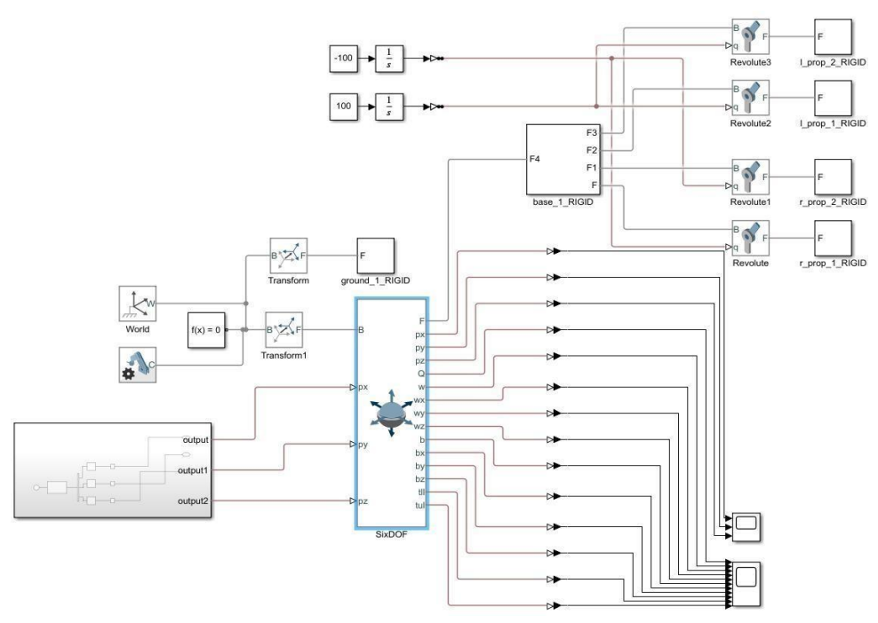
Computational Analysis
Kinematic analysis using MATLAB:
We used simscape to visualize the simulation
We have given velocities as input and calculated the displacement of drone and its behavioural path

Slide 48
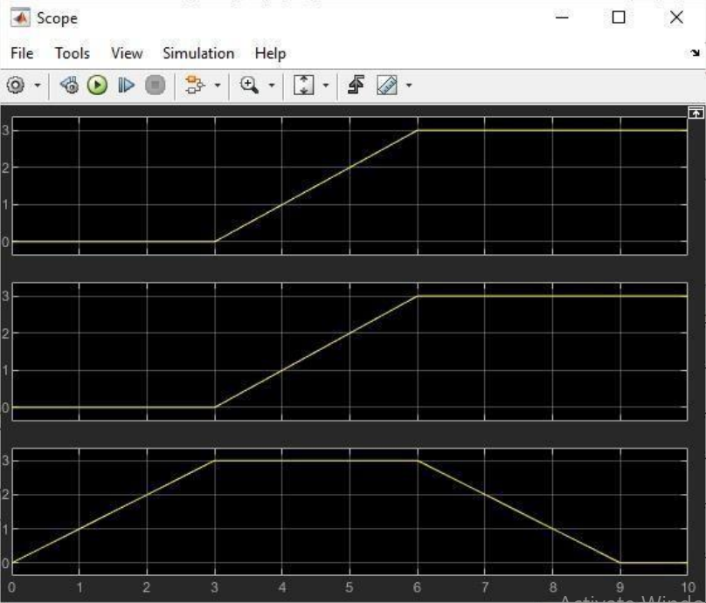
Computational Analysis
Kinematic analysis using MATLAB:
We have used the 6DOF block in Simulink to give the body 3- dimensional motion
We have connected an output signal generator to feed velocities as an input the 6DOF block
Velocity graph (In X, Y and Z direction respectively) in scope 1

Slide 49
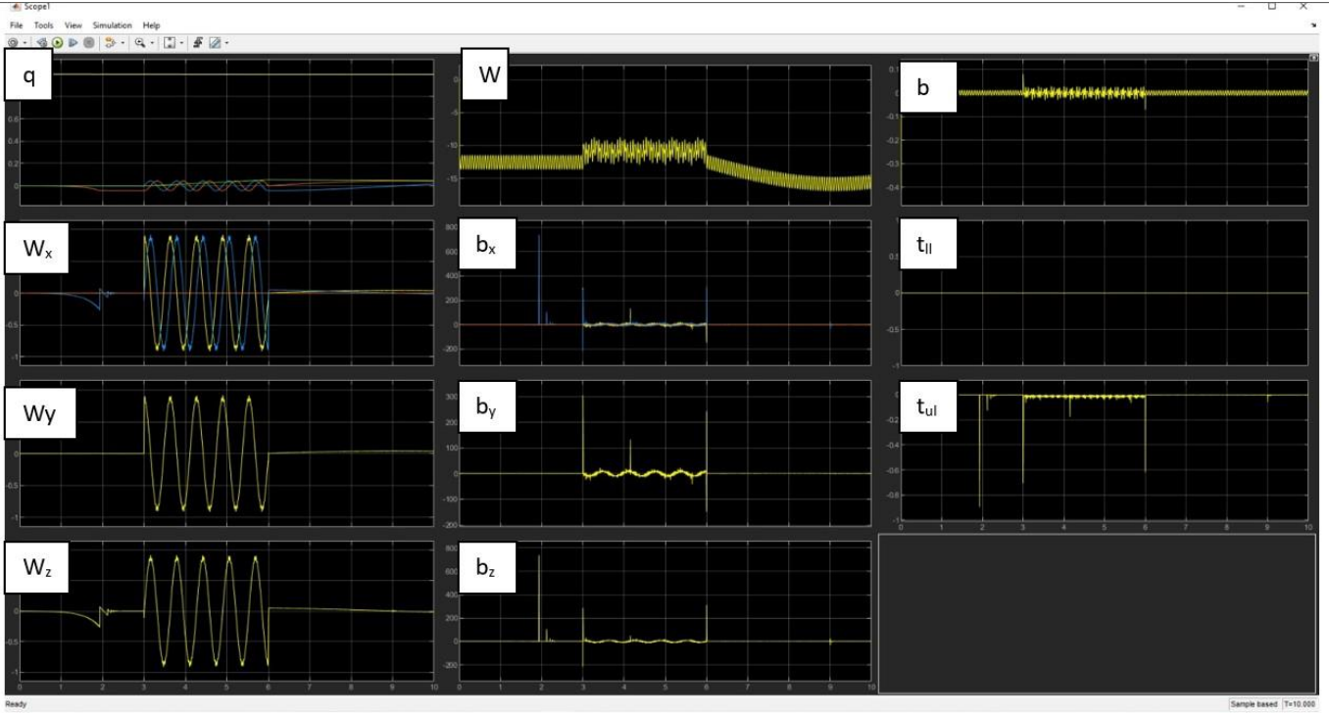
Computational Analysis
Kinematic analysis using MATLAB:
The velocities are with respect to the base(B) i.e., the ground
The output of the 6DOF block consists of follower(F) which is connected to the quadcopter
We also get the input velocities in the output along with position(Q), Angular velocities(w), Angular accelerations(b) and torque
The results were recorded in scope block.
Graphs of Q, w, b, t in scope 2

Slide 50
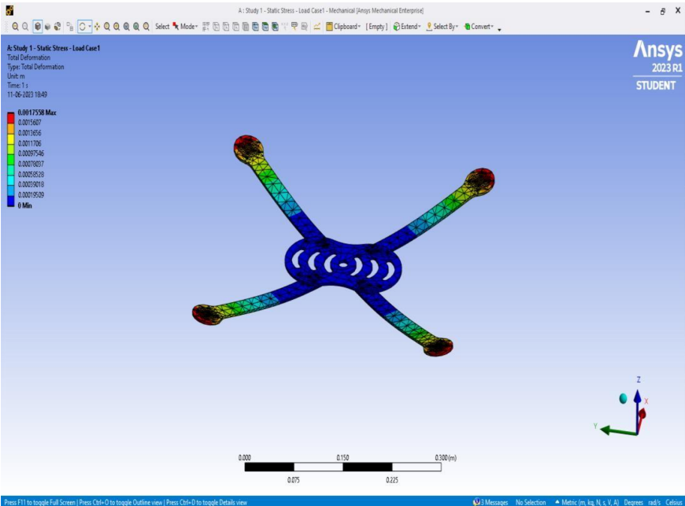
Computational Analysis
Static stress analysis of Frame using ANSYS
We assessed the deformation of our drone frame using an ANSYS static stress analysis
Highest deformation measured varied from 1 mm to 1.7 mm
This study gives important information on the structural integrity of our drone frame, guaranteeing that it can handle the imposed stresses and operate reliably in a variety of settings

Slide 51
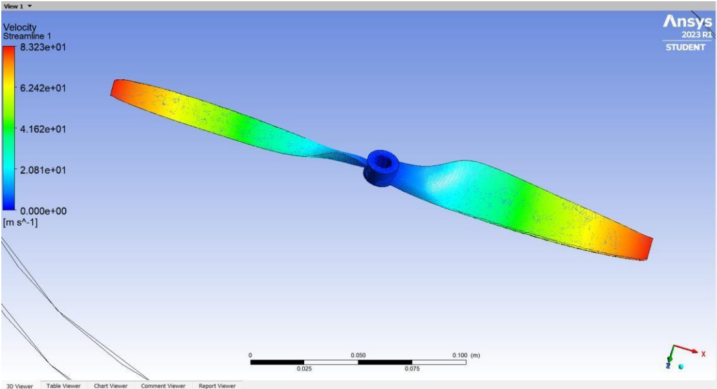
Computational Analysis
Velocity streamline analysis of propeller on Ansys

Slide 52
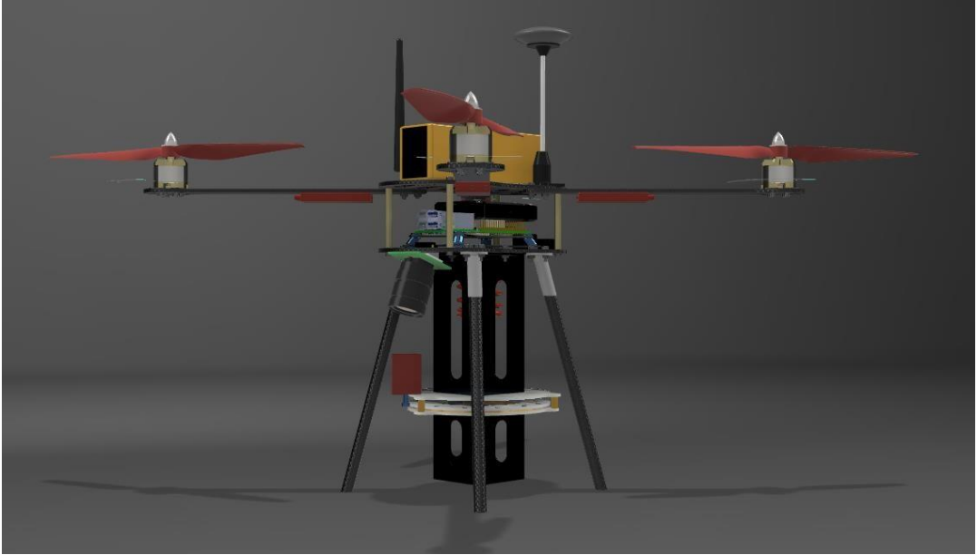
Optimized Final Design
Our drone is built with a lightweight carbon fibre frame and an X-shaped quadcopter layout

Slide 53
Optimized Final Design
2. To provide lift for steady flight, the propulsion system features 1045 propellers on the
motors
3. The payload mechanism is screwed firmly to the bottom of the base plate, allowing for
quick payload deployment
4. A camera is also attached at the bottom to record a large coverage area
5. The landing gear is comprised of carbon fibre rods with rubber studs at the bottom,
which provides strong support and ensures safe landings
6. This complete design combines strength, agility, and functionality, making it suitable for
a wide range of applications.

Slide 54
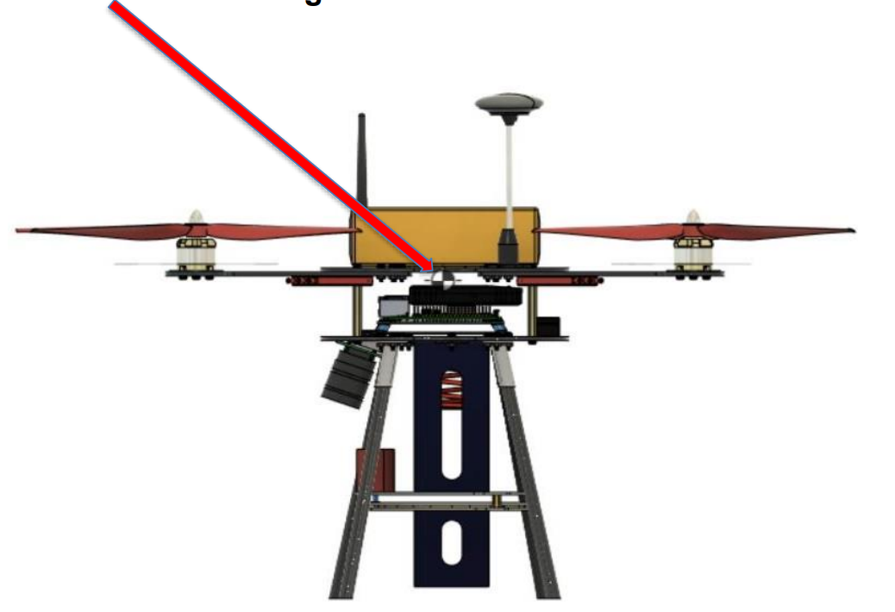
Optimized Final Design
7. CG of final design

Slide 55
Detailed Weight Breakdown
Drone Frame
Component | Weight | Quantity | Net Weight(gms)
Arms | 28 | 4 | 112
Base Plate | 90 | 1 | 90
Legs | 12 | 4 | 48
Propeller | 13 | 4 | 52

Slide 56
Detailed Weight Breakdown
Electronic Components
Component | Weight | Quantity | Net Weight(gms)
Motor | 70 | 4 | 280
Pixhawk | 40 | 1 | 40
Raspberry Pi | 45 | 1 | 45
Camera | 53 | 1 | 53

Slide 57
Detailed Weight Breakdown
Electronic Components
Component | Weight | Quantity | Net Weight(gms)
ESC | 35 | 4 | 140
GPS | 26 | 1 | 26
VTX | 25 | 1 | 25
Receiver | 25 | 1 | 25
Battery | 446 | 1 | 446

Slide 58
Detailed Weight Breakdown
Payload Mechanism
Component | Weight | Quantity | Net Weight(gms)
Frame | 140 | 1 | 140
Servo Motor | 13 | 1 | 13
Spring | 15 | 1 | 15
Buffer (wires and fasteners) |  |  | 150
TOTAL |  |  | 1700

Slide 59
UAV Performance Recalculation
Power Required for the mission:
Power consumed by Motors:
Maximum current draw is 18A
Battery provides voltage of 11.1 V
Max Power = Voltage x Current
Power = 11.1V x 18 A = 200 W
Max Power consumed by 4 Motors = 4 X 200 = 800 W

Slide 60
UAV Performance Recalculation
Power Required for the mission:
Power consumed by Pixhawk 2.4.8 :
Maximum current draw = 2.5A
Required power supply = 5V
Max Power = Voltage x Current
Max Power = 5V X 2.5A = 12.5 W
Power consumed by raspberry pi ranges from 3.5-4 W
Power consumed by camera = 2 W
Assumed losses = 5 W
Total maximum power required (Approx…) = 800+12.5+2+5W = 819.5 W

Slide 61
UAV Performance Recalculation
Endurance estimation:
The motor can draw a maximum of 18 A for a maximum thrust of 1130 gm.
Each engine must produce a safe 600 grammes of force for the drone to hover. Each motors draws 8A assumed.
The total average current drawn by all motors will be 8x4= 32 A.
Calculated flight time will be (6.2/32) x 60 = 11.625 minutes

Slide 62
Bill of Materials
Sr.no. | Part Name | Specs/Material | Quantity
1. | Frame | Carbon fibre | 1
2. | Motor | DYS D2836-7 1120KV | 4
3. | Battery | 6200MAH 40C LI-PO BATTERY | 1
4. | GPS | Pixhawk 4 Neo M8N GPS | 1
5. | Flight controller | Pixhawk V2.4.8 | 1
6. | ESC | ReadytoSky 40A 2-4S ESC | 4
7. | Propeller CW | Carbon Nylon 1045 | 2
8. | Propeller CCW | Carbon Nylon 1045 | 2

Slide 63
Bill of Materials
Sr.no. | Part Name | Specs/Material | Quantity
9. | Payload Dropping Mechanism | Acrylic | 1
10. | microcontroller | Raspberry Pi 4 | 1
11. | Camera | Raspberry Pi High Quality Camera | 1
12. | Telemetry Kit | Boscam 32Ch Wireless AV Transmitter TS832 Receiver RC832 | 1
13. | Landing gear | Carbon fibre | 4

Slide 64
Bill of Materials
Sr.no. | Part Name | Specs/Material | Quantity
14. | Buzzer | Pixhawk kit | 1
15. | Receiver | FS-R6B FlySky 2.4Ghz 6CH Receiver | 1
16. | M3 x 8mm screws and nut
17. | PPM encoder | Pixhawk kit | 1

Slide 65
Methodology for Autonomous Operation
Autonomous Flight
Autonomous Operation using raspberry Pi –
1. Mission setup –
Setup the path for drone by using Mission Planner software
Set the waypoints and altitude to navigate the drone over the desired ground path
2. Installation of Raspbian OS -
Installed latest Raspbian OS on rPi using Raspberry Pi imager and SD card; Used Putty Client to remotely ssh into Raspberry Pi
Connect the rPi and the computer to same network, then find IP address of rPi over that network using Angry IP Scanner software
SSH into rPi using Putty Client. By doing this we can code rPi over a Wi-Fi network

Slide 66
Methodology for Autonomous Operation
Autonomous Flight
Autonomous Operation using raspberry Pi –
3. Connection between Pixhawk and Raspberry Pi – Established connection using UART serial communication protocol.
Steps for establishing UART communication –
▪ Connect the Pixhawk’s telemetry port (Telem2) to the Raspberry Pi’s GPIO
pins. The UART pins used for communication are typically GPIO 14 (TX)
and GPIO 15 (RX)
By default, the Bluetooth module on rPi uses UART so first disable it by making changes in config.txt file: -
sudo nano /boot/config.txt
dtoverlay = disable-bt
pseudo reboot

Slide 67
Methodology for Autonomous Operation
Installation of necessary libraries on rPi
sudo pip install pyserial
pySerial is a Python library to establish and manage serial communication connections.
sudo pip install dronekit
dronekit offers a simplified and Pythonic interface for sending commands, receiving telemetry data, and managing mission planning.
sudo pip install mavproxy
MAVProxy serves as a versatile ground control station that facilitates communication between the Pixhawk and external systems, provides monitoring capabilities, and enables command execution.

Slide 68
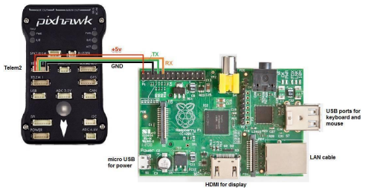
Methodology for Autonomous Operation

Slide 69
Methodology for Autonomous Operation
4. Detection of the hotspot –
First, we set up camera using sudo raspi-config command and then making cghanges
inside interfacing options.
5. pseudo code for python script -
import time.
import cv2 # OpenCV library for image processing.
from dronekit import connect, VehicleMode, LocationGlobalRelative
# Connect to the Pixhawk autopilot
vehicle = connect ('/dev/ttyAMA0', baud=57600, wait_ready=True
target_altitude = h
vehicle.simple_takeoff(target_altitude)
# Wait until the vehicle reaches the desired altitude
# Function to handle image detection and payload drop
def detect_and_drop():
# Capture and process images for object detection

Slide 70
Methodology for Autonomous Operation
camera = cv2.VideoCapture(0) # Using the appropriate camera device
while True:
_, image = camera.read()
# Process images using previously developed object detection model
# If the object is detected:
if object_detected:
print ("Object detected")
# Change vehicle control to Raspberry Pi
vehicle.mode = VehicleMode("MANUAL")
# Descend to an altitude of h2 meters
target_altitude = h2
# Wait until the vehicle reaches the desired altitude
# Drop the payload
drop_payload()
# Change vehicle control back to the mission planner
vehicle.mode = VehicleMode("GUIDED")
# Close the camera
camera.release()

Slide 71
Methodology for Autonomous Operation
# Function to handle mission planner commands
def handle_mission_planner_commands():
# Continuously listen for mission planner commands
while True:
# Process mission planner commands
# ...
# If a specific condition is met (e.g., a command to start object detection):
if start_detection_condition:
# Transfer control to Raspberry Pi for image detection and payload drop
detect_and_drop()
# Resume mission planner control after payload drop
# Executing the mission planner command handling function in a separate
thread
import threading.
mp_thread = threading.Thread(target=handle_mission_planner_commands)
mp_thread.start()

Slide 72
Methodology for Autonomous Operation
6. Payload drop logic –
Developed a programe on the Raspberry Pi that monitors the ML model's output for target detection.
When the target is detected, command will be sent from the Raspberry Pi to the Pixhawk to trigger the payload release mechanism.
This is done by sending a specific MAVLink command or using custom signals connected between the Raspberry Pi and the Pixhawk.
7. Resuming the control -
The Raspberry Pi sends a command to the Pixhawk flight controller to initiate the payload drop at the designated altitude.
After payload drop, the Raspberry Pi sends another command to the Pixhawk to indicate the completion of the drop and instruct it to resume listening to commands from Mission Planner through the first communication channel.

Slide 73
Methodology for Autonomous Operation
Autonomous execution of script -
Developed the system in such a way that the script starts executing with a specific time delay after the power is connected.
We don’t need to be connected to the network for execution of script.
We monitor the voltage levels on the GPIO pins to detect the power connection.

Slide 74
Innovation
Our drone design includes various novel elements that improve its performance and utility
Our Innovation include-
Glass Fibre Reinforced Polymer (GFRP) layer covering to the landing gear
to considerably boost its strength and endurance
A Bio-inspired payload mechanism inspired shutter of a camera
light, fast, and very efficient in terms of timely dropping of payload
Human centered payload
Slots matching the width of average human finger
to ensure easy loading of payload

Slide 75
Innovation
Our Innovation include-
Spring loaded payload mechanism
provides extra velocity to payload while dropping which lets it overcome the air resistance coming from the drone and reduces its deflection
An extra run to payload and made it in the shape of the vertical box with less clearance
To ensure the straight dropping of the payload without any deflections

Slide 76
THANK YOU
TEAM ALTITUDE
COEP Tech

